Slide 1





Car Damage Assessment Using Machine Learning

Slide 2
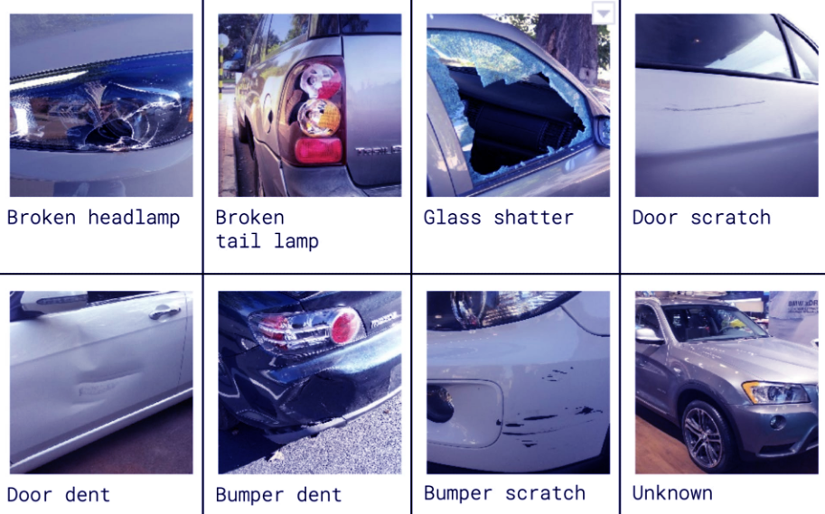
The essence of the database:
The illustration show sample images from the various classes in the dataset.
Note that the unknown class contains images of cars that are in either pristine or wrecked condition.

Slide 3



Questions about the database:
What are the success rates in image classification?
Is machine learning effective in classifying a large number of classes?
How much does modeling the image into a vector affect learning? (Flatten VS VGG)
How much do image features affect learning?

Slide 4
Algorithms
CNN
A concept of a neural network, Its main attributes may be that it consists of convolution layers, pooling layers , activation layers etc.
SVM
Works by mapping data to a high-dimensional feature space so that data points can be categorized, even when the data are not otherwise linearly separable. A separator between the categories is found, then the data are transformed in such a way that the separator could be drawn as a hyperplane. Following this, characteristics of new data can be used to predict the group to which a new record should belong
CNN
SVM
works by finding the distances between a query and all the examples in the data, selecting the specified number examples (K) closest to the query, then votes for the most frequent label (in the case of classification) or averages the labels (in the case of regression)
KNN
DT use multiple algorithms to decide to split a node into two or more sub-nodes. The creation of sub-nodes increases the homogeneity of resultant sub-nodes. In other words, we can say that the purity of the node increases with respect to the target variable. The decision tree splits the nodes on all available variables and then selects the split which results in most homogeneous sub-nodes
DT
KNN
DT

Slide 5
Results
75
50
25
0
CNN
SVM
KNN
DT
Using VGG
Using Flatten

Slide 6
Main Challenges
Loss of information obtained from the image columns as a result of performing Flatten (converting the image to vector) Overcoming: By using VGG
?

Slide 7
Techniques
Bilateral filter
Gaussian Filter Bilateral Filter

Slide 8
Techniques
Sharp Via Laplacian Of Gaussian
Original Sharpen

Slide 9
Techniques
Canny
Original Edges

Slide 10
Techniques
Histogram Equalization
Before After

Slide 11
Techniques
White Balance

Slide 12
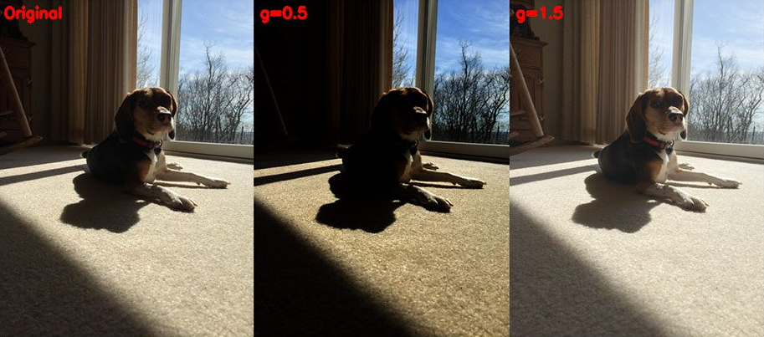
Techniques
Gamma Correction

Slide 13
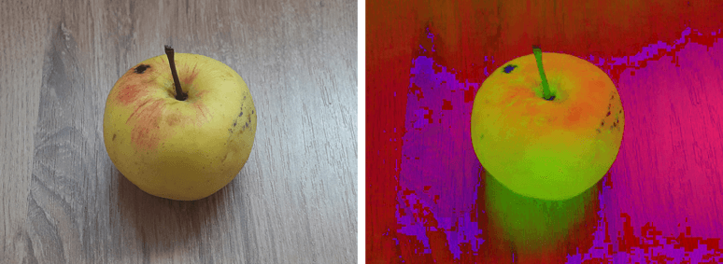
Techniques
HSV
RGB HSV

Slide 14
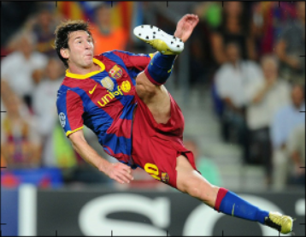
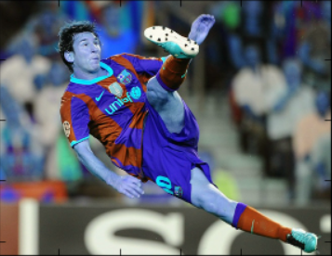
Techniques
BGR
RGB BGR

Slide 15
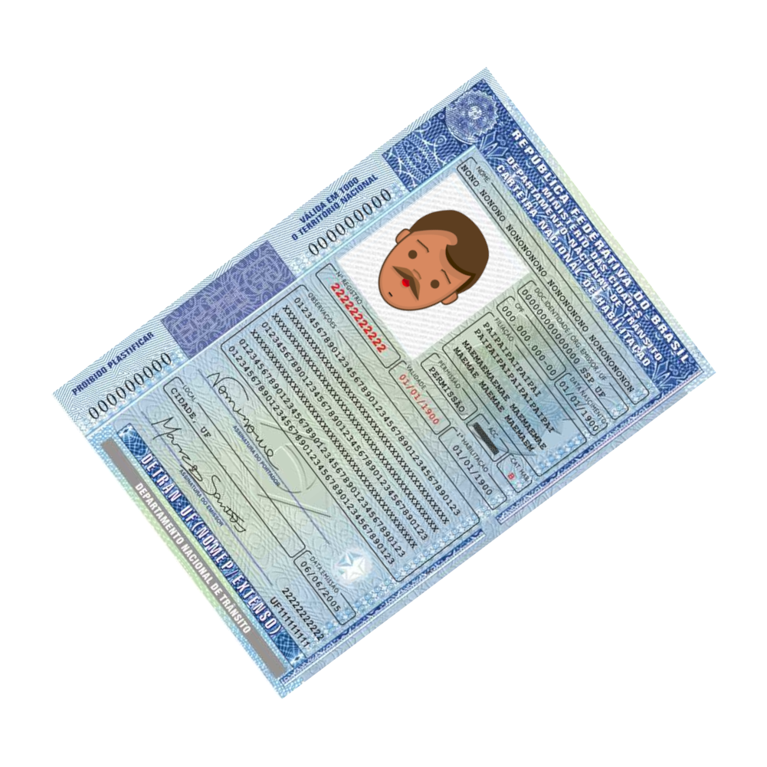
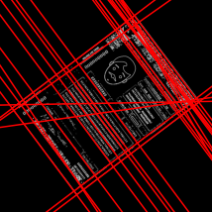
Techniques
Hough Line Transform

Slide 16
Techniques
… And more tweaks like:
Mean reduction
Resized Images (112X112)

Slide 17

Techniques Results

Slide 18
Credits
Special thanks to all the people who made and released these awesome resources for free:
Presentation template by SlidesCarnival
Photographs by Unsplash

Slide 19
Presentation design
This presentation uses the following typographies:
Titles: Lexend Deca
Body copy: Muli light
Download for free at:
https://www.lexend.com/
https://www.fontsquirrel.com/fonts/muli
You don’t need to keep this slide in your presentation. It’s only here to serve you as a design guide if you need to create new slides or download the fonts to edit the presentation in PowerPoint®

Slide 20

Thanks!

